Slide 1
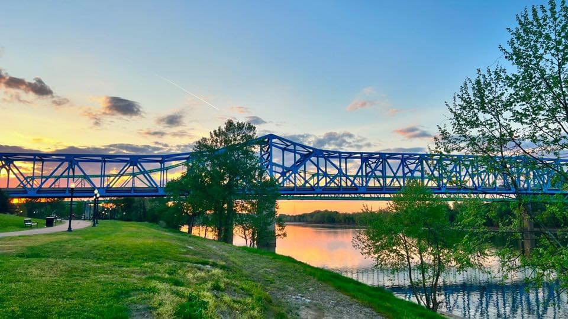
Photo Credit: Visit Ashland, KY Facebook Page
KYTC Statewide Transportation Planning Meeting
October 16, 2024
Ashland Train Depot, Ashland, KY
Chris Chiles, Executive Director
cchiles@kyovaipc.org; 304-523-7434
www.kyovaipc.org

Slide 2
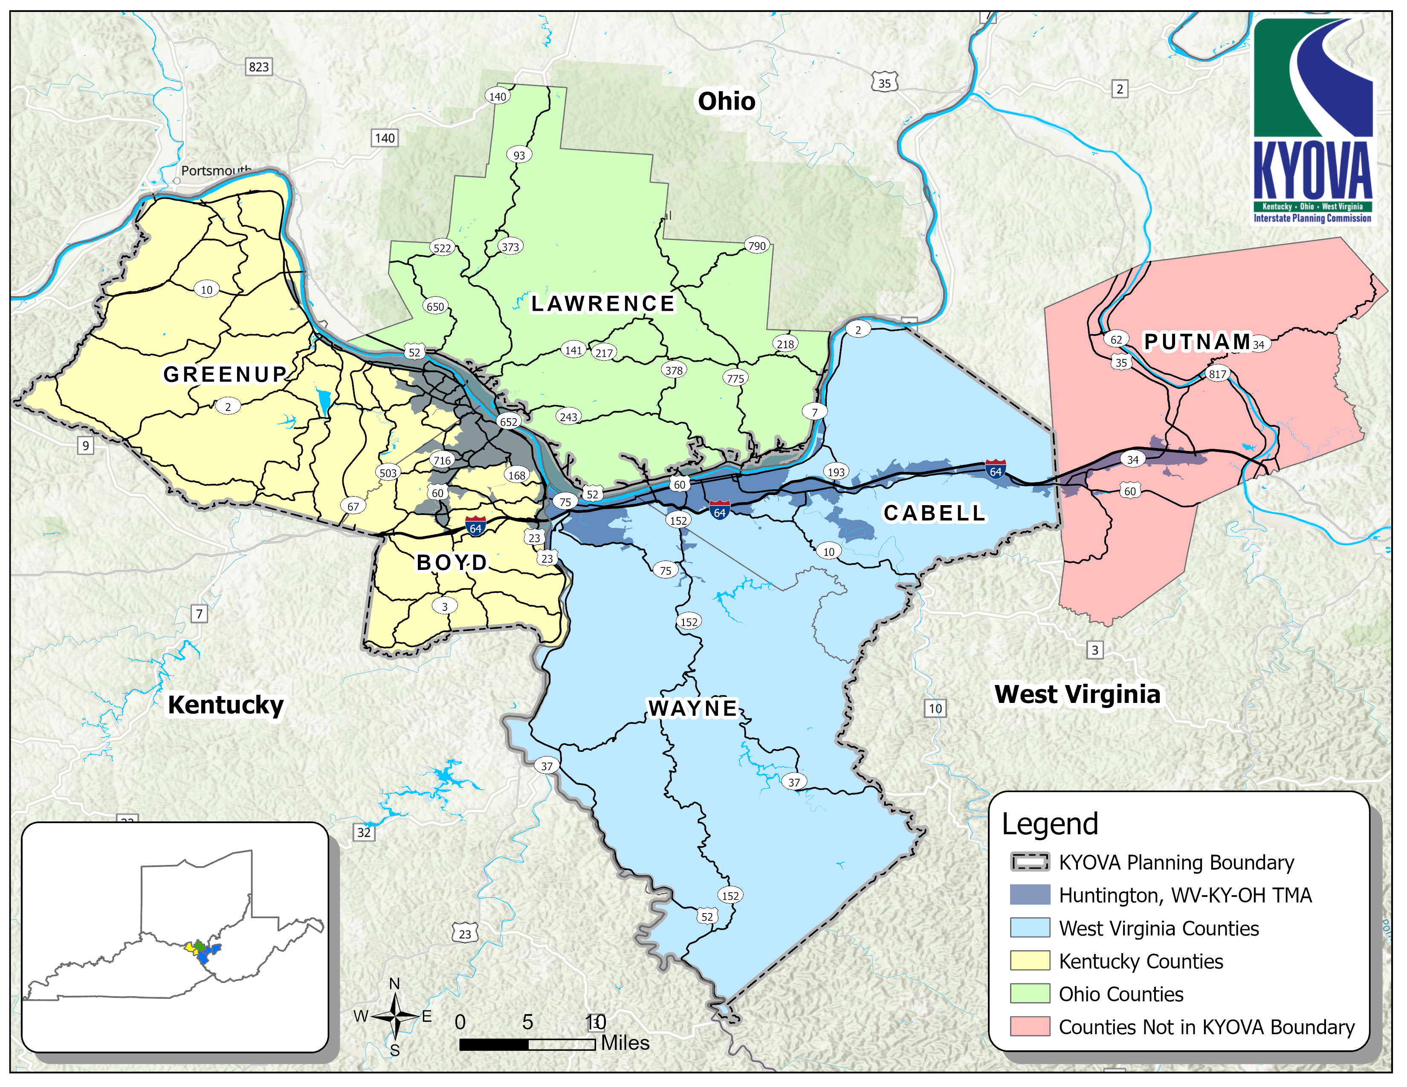
Planning area
5 Counties in Planning Area
MSA Population ~ 360k
3 States
3 FHWA Divisions
3 State DOTs
3 EPA Regions
3 FTA Regions
3 US EDA Regions

Slide 3
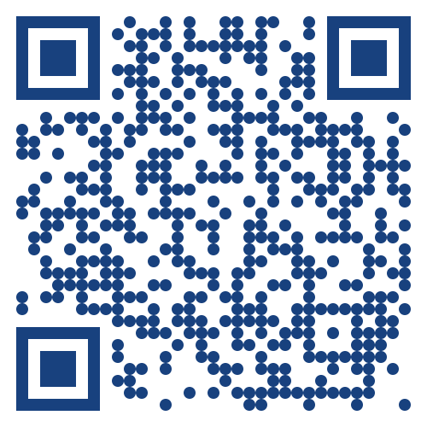
Web-Based Project Information
Partnership between KYOVA and EcoInteractive for E-TIP
Consistency
Public facing
Project location
Cost
Funding source
Map

Slide 4
Completed Projects with STBG Funds
Downtown Ashland Streetscape
Flatwoods sidewalks along Powell Lane
Russell sidewalks along Kenwood Drive/Seaton Drive
15th Street ADA sidewalks – City of Ashland
Safety improvements to railroad crossing in Queen’s Landing/Lerita Street in Lloyd
Bus Stop Shelters & Bike racks at various locations – City of Ashland
Turn lane at Argilite School
Boyd/Greenup Freight Plan
Boyd/Greenup Small Urban Study
Boyd/Greenup Bicycle and Pedestrian Plan
Rush Off Road Feasibility Study
Westwood Bike/sidewalk study
Photo Credit: vistaky.com

Slide 5
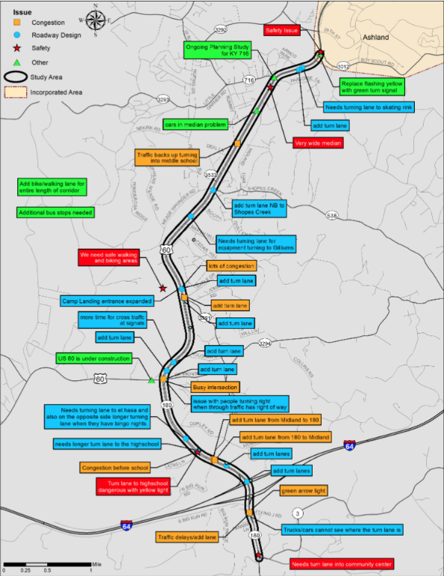
Active Projects with STBG Funds
Kentucky Specific
US60/KY180 Corridor Study – Boyd County
Roundabout at KY716/KY3293 Intersection – Boyd County
Downtown Greenup Riverwalk – Greenup County
Tri-State
Safe Streets and Roads for All Action Plan
Regional Freight Plan
Congestion Management Process
Travel Demand Model Update

Slide 6
QUESTIONS?
Chris Chiles, Executive Director
cchiles@kyovaipc.org
304-523-7434
www.kyovaipc.org

